Slide 1

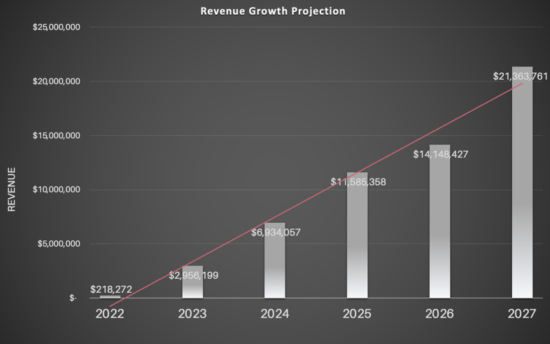
Ignite program helps companies to do two things:
build a revenue strategy and
boils it down into quick actionable steps that enables the commercial team to get it done.
that work in today’s complex marketplace to help you get to where you want to go.
PROBLEM
For Sales and Marketing :
They don’t have time and in some cases skill to develop a plan that is built to be successful in today’s marketplace.
They are tactical, not strategic. And they are looking for the next gen playbook.
Business Owners: IGNITE bridges the gap between financial roadmaps and sales & marketing execution of plans. Building a plan that works in today’s marketplace is difficult.
90% of plans and tactics overlook millions in revenue and don’t connect nor yield results.
SOLUTION
FOCUS MARKETS Land & Expand
Real Estate Owners and Investors:
- Hotels
- Assisted Living
- Multi-Family
Professional Services
Start ups
Ignite, a SaaS program, helps companies create a data-decision financial roadmap that simplifies and helps drive performance within sales and marketing teams to get to results.
COMPETITIVE LANDSCAPE
“Frankenstein-ed” Excel Documents
Status Quo
Legacy Approach
Complacency
SCOPE OF MARKET
TAM: 15,000 companies
SAM: $500 million
SOM: $150 million
FUTURE REVENUE FORECAST
THE ASK $750K - $1 million
Move current platform to 1.0 version
Scale technology to take on the growth model of the reseller and large scale
Wizard, AI, and ML
Create Dashboards and enhance reporting
Attract and retain top-level talent
Fund Go-to-Market Strategy

Slide 2

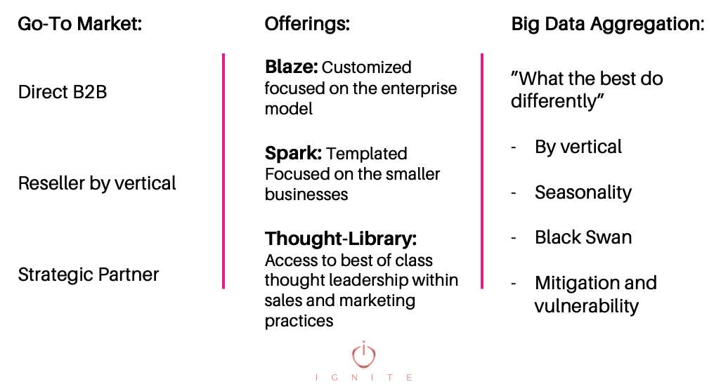
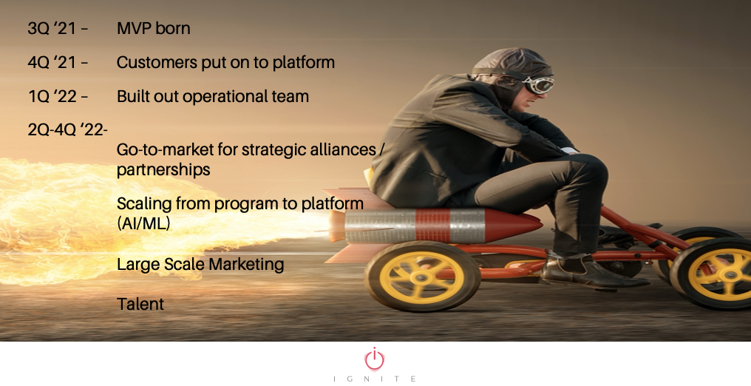
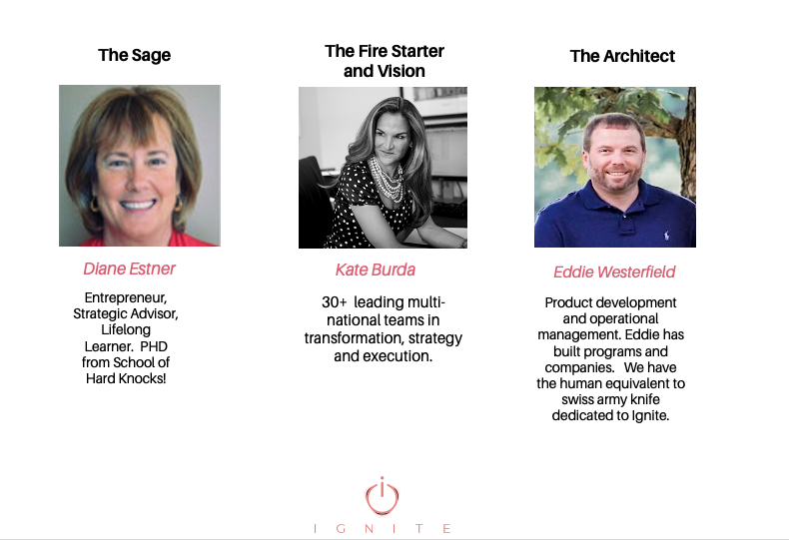
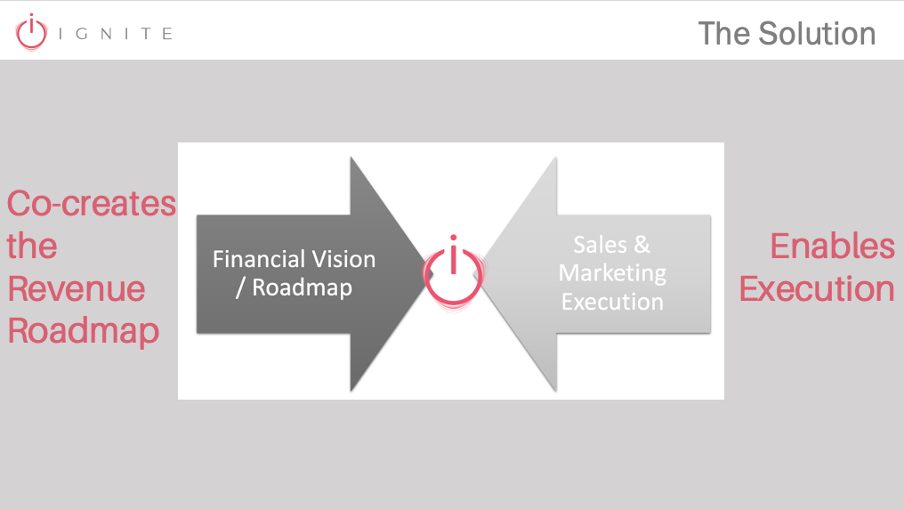
Business Model
Traction
Our customers today:
A hotel management firm
A wine distributor
Multi-national asset
management firm
Milestones to Date
Meet the Core Team
Over 100+ years in strategy and building businesses
Differentiator
Cross-Vertical solution for SMB to full enterprise
$1.3- $2 million dollars of unrealized revenue resultant from the program.
“I couldn’t find a solution for our clients, so I built it”
Kate Burda
www.ignites.info

